Slide 1
System and Network Administration
udev

Slide 2
openVPN
A tun interface is a device driver that that looks like point-to-point network hardware to the operating system
A tap interface is similar, but it emulates ethernet rather than point-to-point.
Rather being connected to a wire, the driver connects to “user space”, where a program can open the device just like a file and read and write packets from and to it.
The VPN essentially links a local tun or tap device with a remote one of the same type.
packets are encrypted and encapsulated in UDP

Slide 3
SO …
Where do tun/tap devices come from?
How do I know what modules are loaded into the kernel?
We need to understand
device drivers
modprobe, lsmod
udev, /dev/ and /sys/

Slide 4
Kernel Modules
Device Drivers
Accessed through special files in the /dev directory
Major device number
Minor device number (unit)
udev - Autosense devices
udevd
/etc/udev/udev.conf
Added or removed while kernel is running
Commands:
lsmod
insmod
rmmod
modprobe
Device files created with
mknod name type major minor
or with
cd /dev
./MAKEDEV pty

Slide 5
Kernel modules and Device Drivers
Every device in the system is represented by a file - even to read from memory is to read from a file.
In kernel space, the virtual file system (VFS) decodes the file type and transfers the file operations to the appropriate channel, like a filesystem module in case of a regular file or directory, or a device driver in case of a device file.
All of the functions used to access a specific device are jointly referred to as the device driver.
Device drivers must be statically compiled into the kernel or stored on disk as a dynamically loadable module.

Slide 6
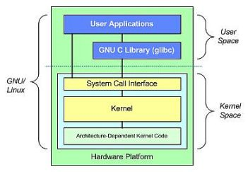
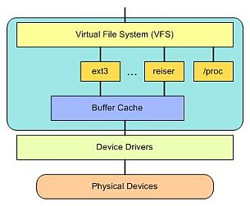

Slide 7
Device Nodes
Device files (also called device nodes) are located in the /dev/ directory.
A device node is a file with type c (for "character" devices, devices that bypass the buffer cache) or b (for "block" devices, which go through the buffer cache).
Each device file is assigned a major number and a minor number.
Traditionally, each device driver has a major device number, and all device files for devices controlled by that driver have the same major number.

Slide 8
Device Files and udev
# ls -l /dev/sda
brw-rw---- 1 root disk 8, 0 March 9 07:56 /dev/sda
Shows type (b=block) and permissions (rw-rw----),
owner (root), group (disk),
major device number (8), minor device number (0),
date (March 9), hour (07:56) and device name (guess :-)
Modern Linux kernels allow multiple drivers to share major numbers, but most devices that you will see are still organized on the one-major-one-driver principle.
The kernel will assign a major/minor number pair when it detects a hardware device.

Slide 9
The kernel and udev
The udev daemon listens to the netlink socket that the kernel uses for communicating with user space applications.
For every detected device, the kernel creates an internal device structure (in “kernel space”) and the driver core sends an event to udev (in “user space”)
If a device driver needs to be loaded, udev calls modprobe with parameters provided by the kernel

Slide 10
/dev/ and /sys/
Once the proper device driver is loaded, udev processes the event (see next) and creates the device node in /dev/
Then, for every device the kernel has detected and initialized, a directory with the device name is created that contains files with device specific properties in /sys/

Slide 11
udev rules
Every event is matched against the set of rules provided in /etc/udev/rules.d/*.rules.
These rules can add or change event environment keys, request a specific name for the device node to be created, add symlinks pointing to the node or add programs to be run after the device node is created.
udev rules can match on any property the kernel exports in /sys/ or adds to the event, and the rule may also request additional information from external programs

Slide 12
udev
From the user space perspective, there is no difference between a device coldplug sequence and device discovery during runtime (hotplug).
All devices that are plugged in or removed will cause an uevent to be sent to the udev daemon, which runs an event process to match against udev rules, create/remove the device node and symlinks as required, and possibly run specified programs to set up/clean up after the device.

Slide 13
modprobe
modprobe is used to load and unload kernel modules
lsmod is used to list currently loaded modules
If you don’t know why a module is needed, use modinfo to find information about it
There is a fuller explanation on the website

Slide 14




